Slide 1
Table of Contents
Project 1
Project 2
Project 3
Project 4
Project 5
Exploring RF Data with Python Dash and Pandas!
Tkinter Application for Mobile Signal Data Management
CSV_ Generator Application (Gladiator & Wind s/w).
CSV_Cleaner
KPI_Summery

Slide 2
Table of Contents
Project 1
Project 2
Project 3
Project 4
Project 5
Exploring RF Data with Python Dash and Pandas!
Tkinter Application for Mobile Signal Data Management
CSV_ Generator Application (Gladiator & Wind s/w).
CSV_Cleaner
KPI_Summery

Slide 3
Project 1
Exploring RF Data with Python Dash and Pandas!

Slide 5

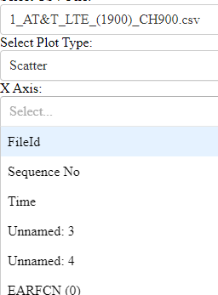
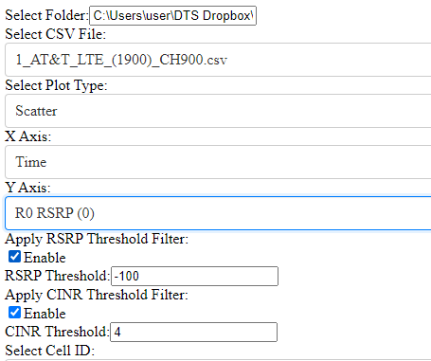
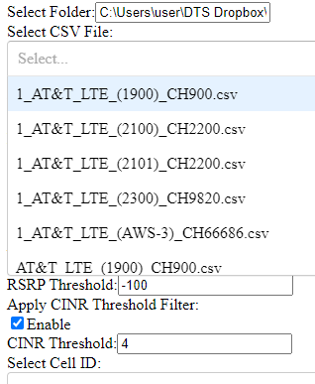
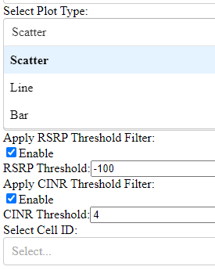
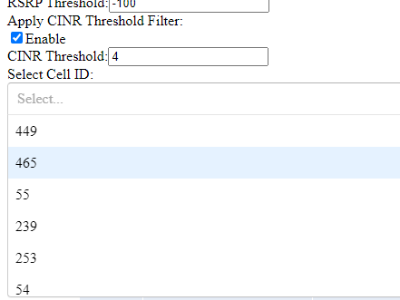
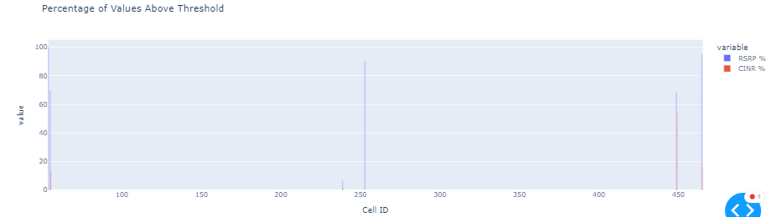

Slide 6
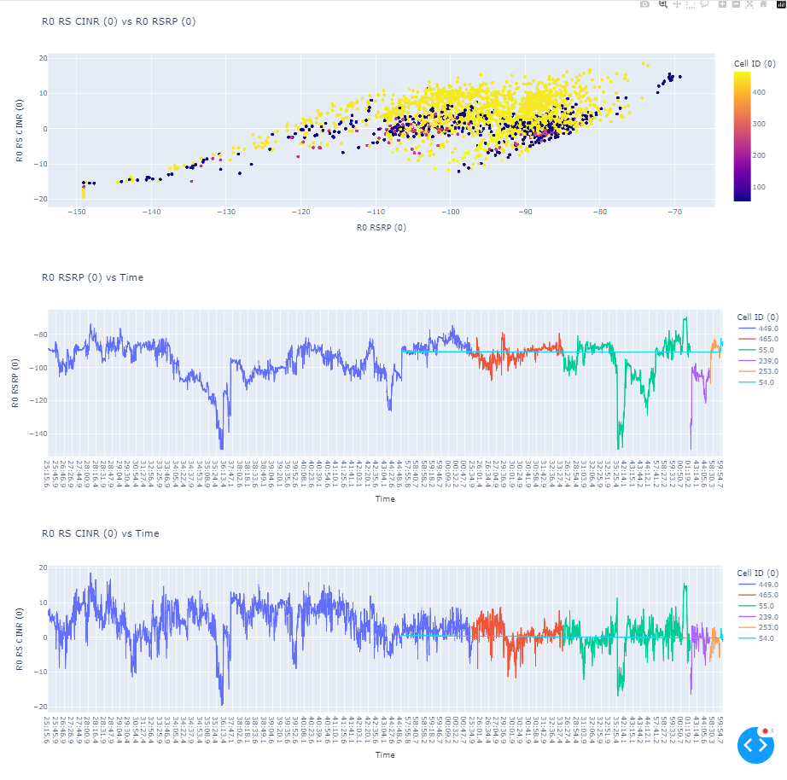

Slide 7
Project 2
Tkinter Application for Mobile Signal Data Management

Slide 9
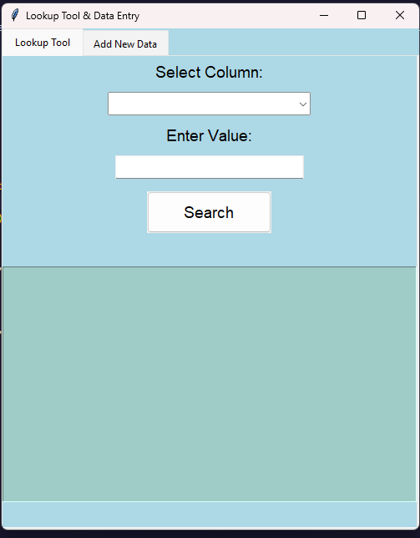
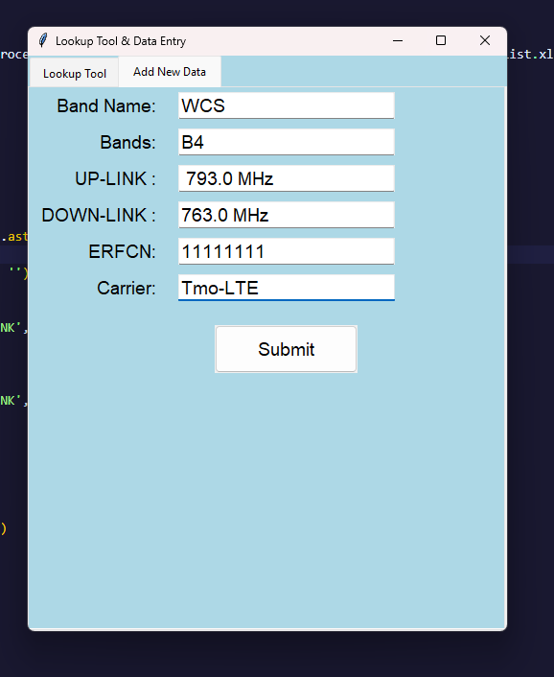
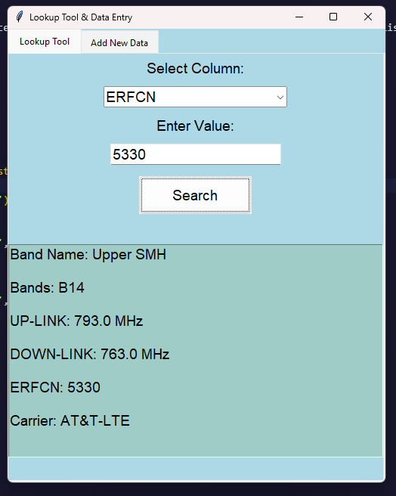
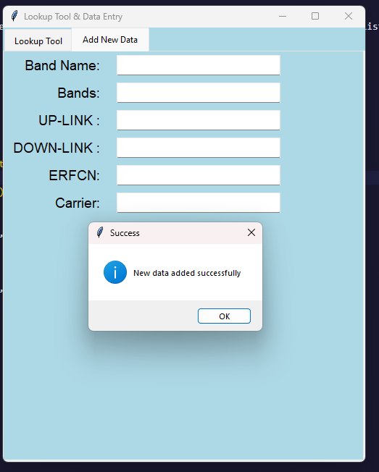

Slide 10
Project 3
CSV_ Generator Application

Slide 11
Gladiator CSV_ Generator Application

Slide 12
Source Path
Destination Path
Folder Mapping
Renaming
Execute

Slide 13
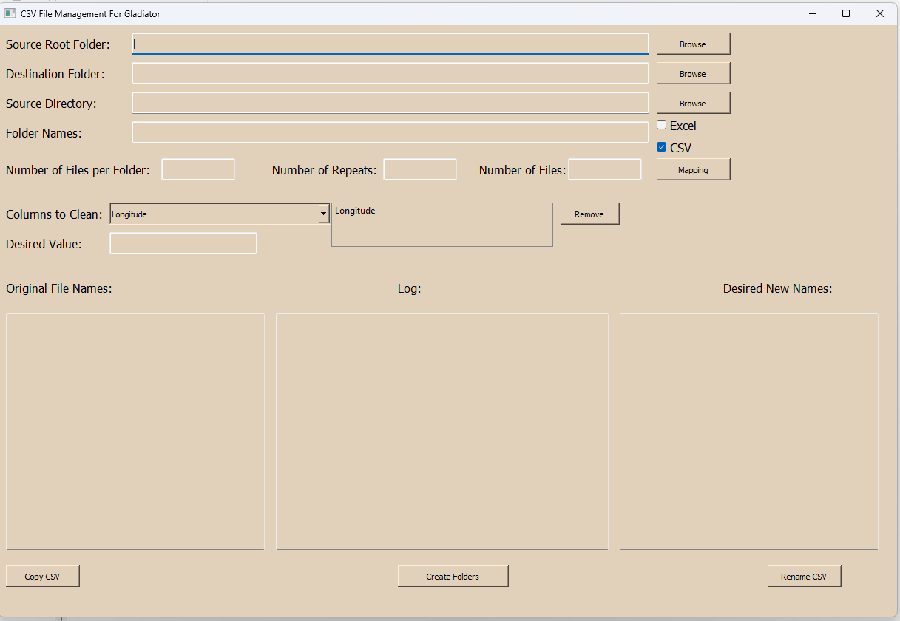
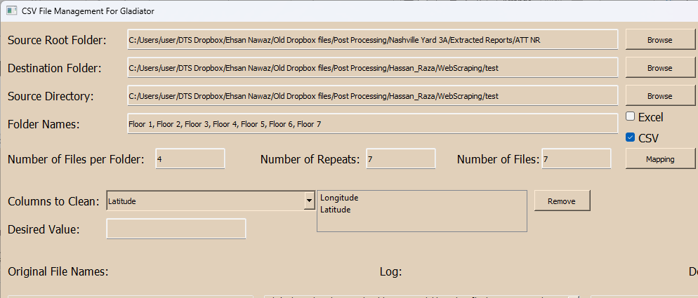
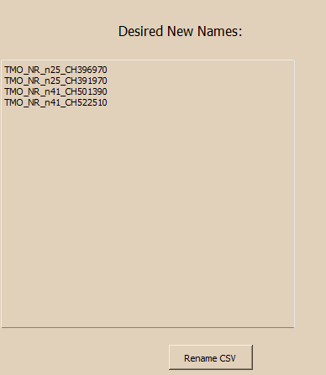

Slide 14
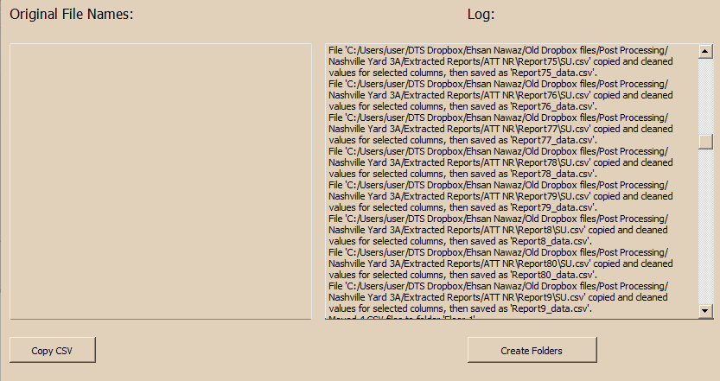
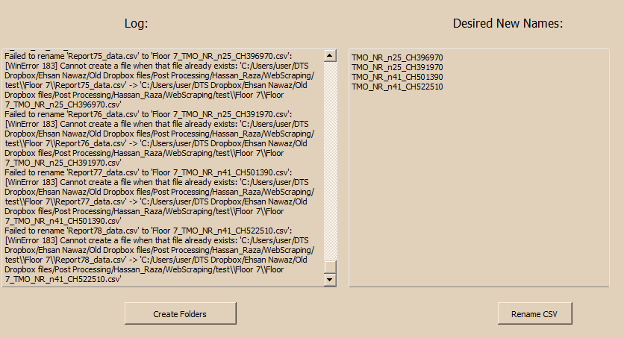
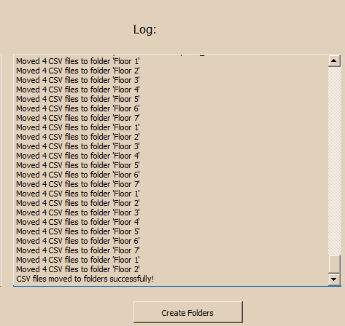
CSV Copy Successfully
Click 1st
Result Renamed Successfully
Folder create and CSV moved Successfully
Click 3rd
Click 2nd

Slide 15
Wind-Console CSV_ Generator Application

Slide 16
Source Path
Folder Creation
Destination Path
Selection of File Type
Select Files:[CSV/Excel]
New File names
Execute

Slide 17
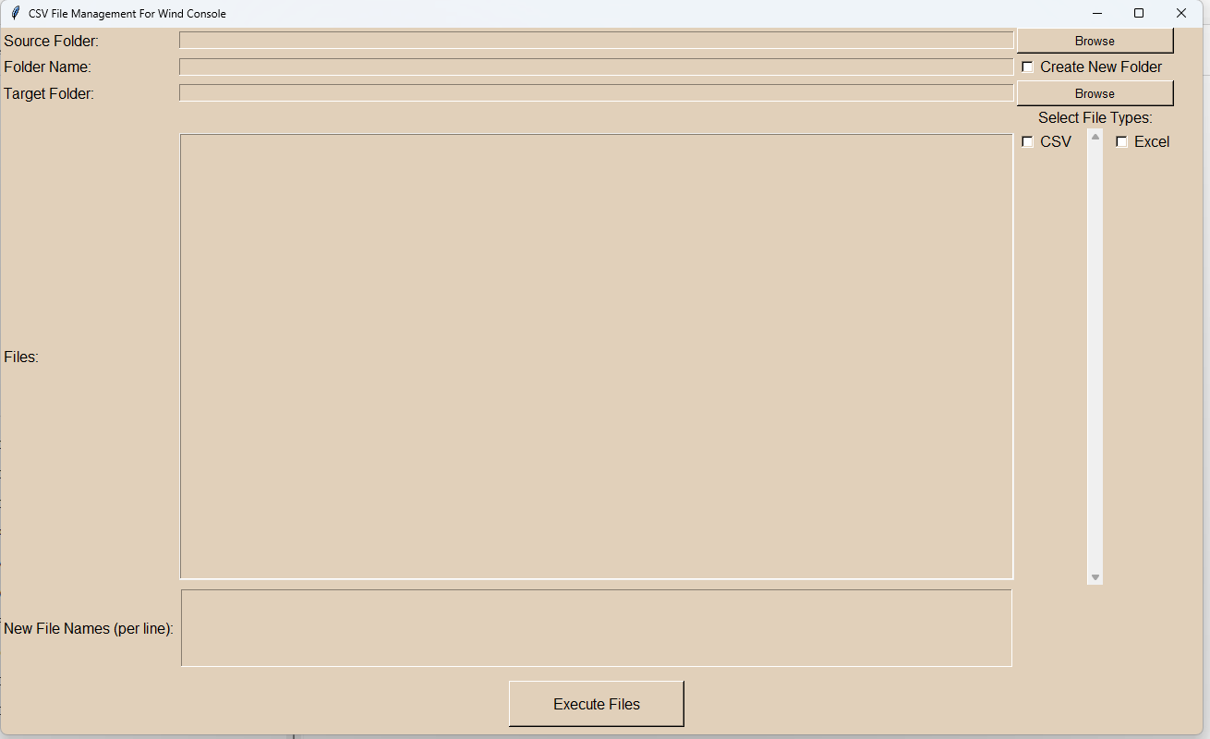
Home Page

Slide 18
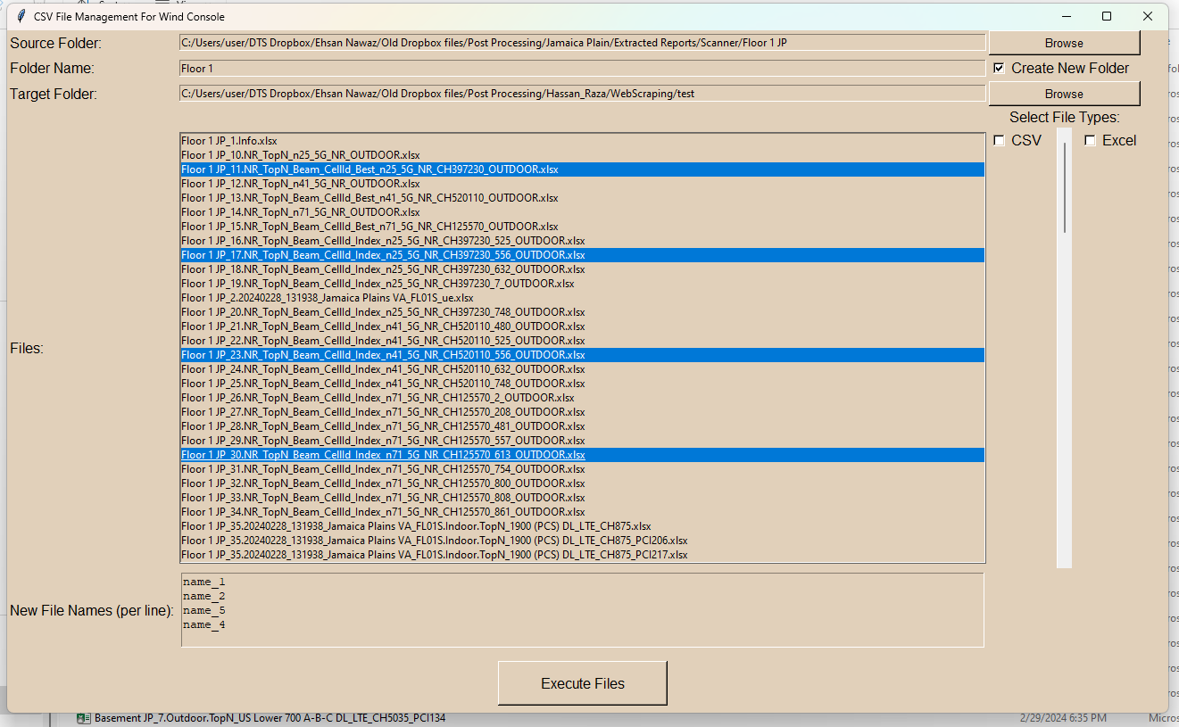
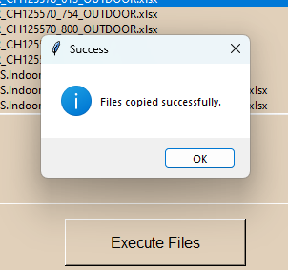
1
{
2
3
4
5
8
6
7

Slide 19
Project 4
CSV_Cleaner

Slide 20
Source Path
(Folder)
Column Selection (Excel/CSV)
New Column Add / Remove
Selection Option for Remove Rows with missing Value
Enter Value That is to clean
Execute
Check Logs forr Result

Slide 21
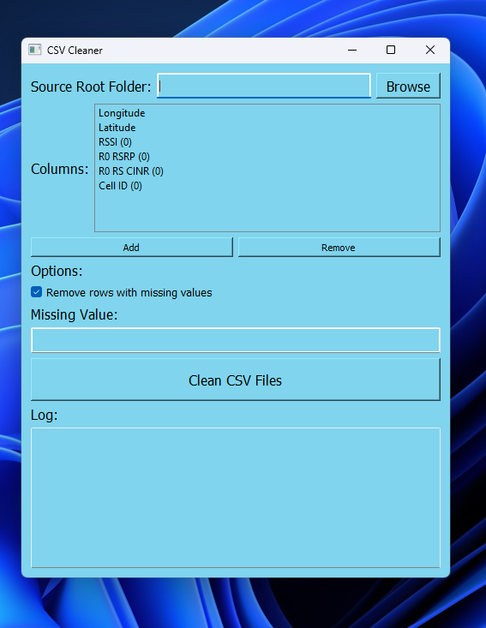
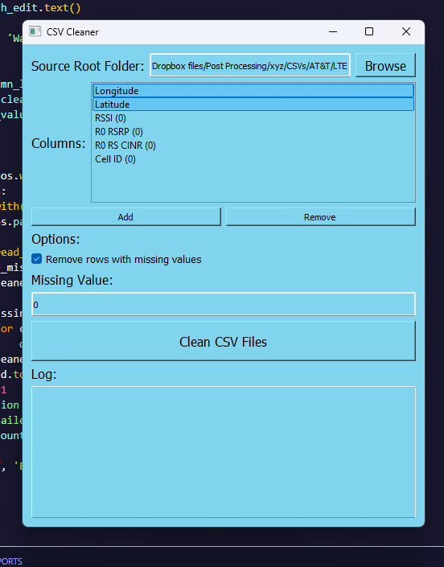
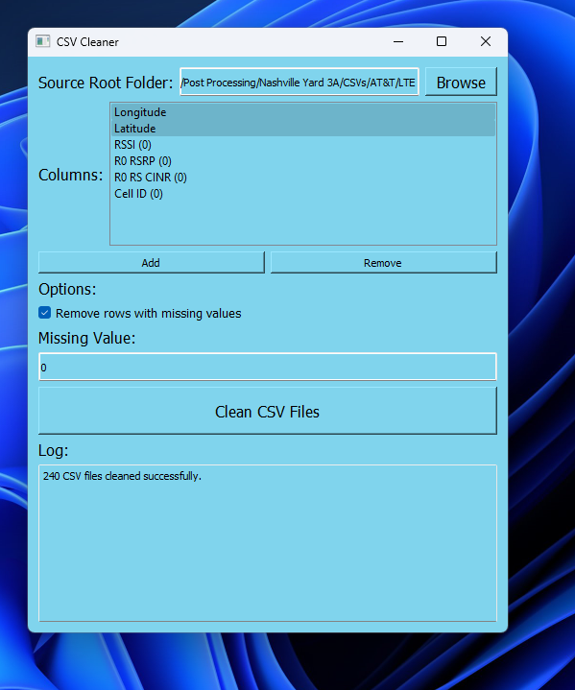
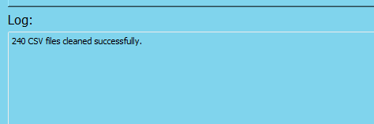



Home Page
Path and Column Selected
Result

Slide 22
Project 5
KPI_Summery

Slide 23
RSRP Colum Names
& CINR Colum Names
Conditions for RSRP &CINR
Run Analysis
Select Path
Refresh or Exit

Slide 24
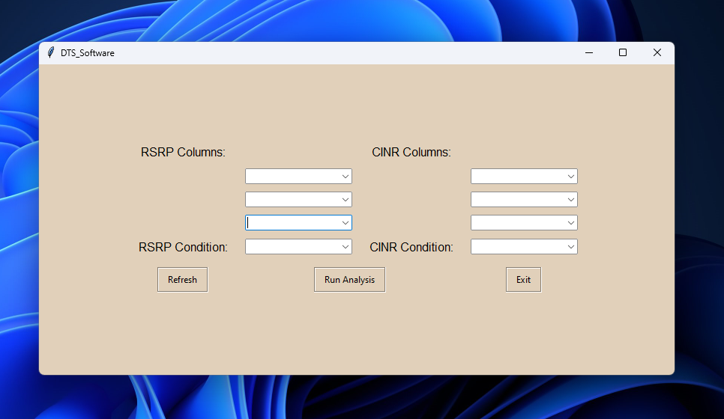
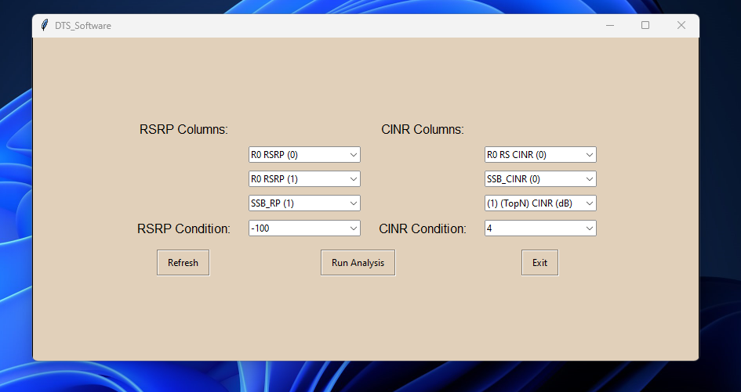
Data Entered
Home Page

Slide 25
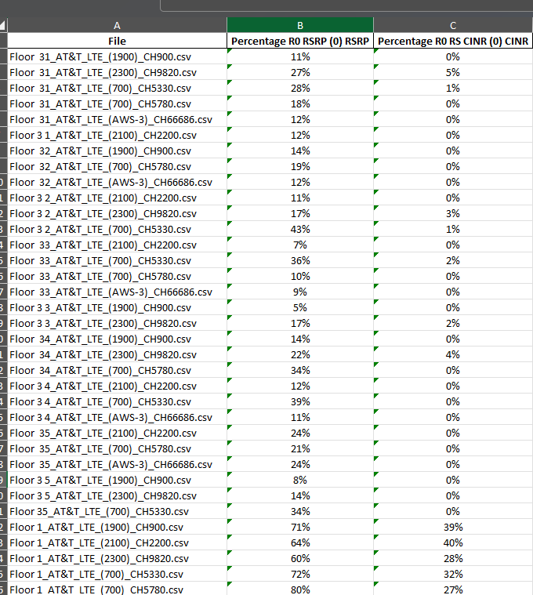
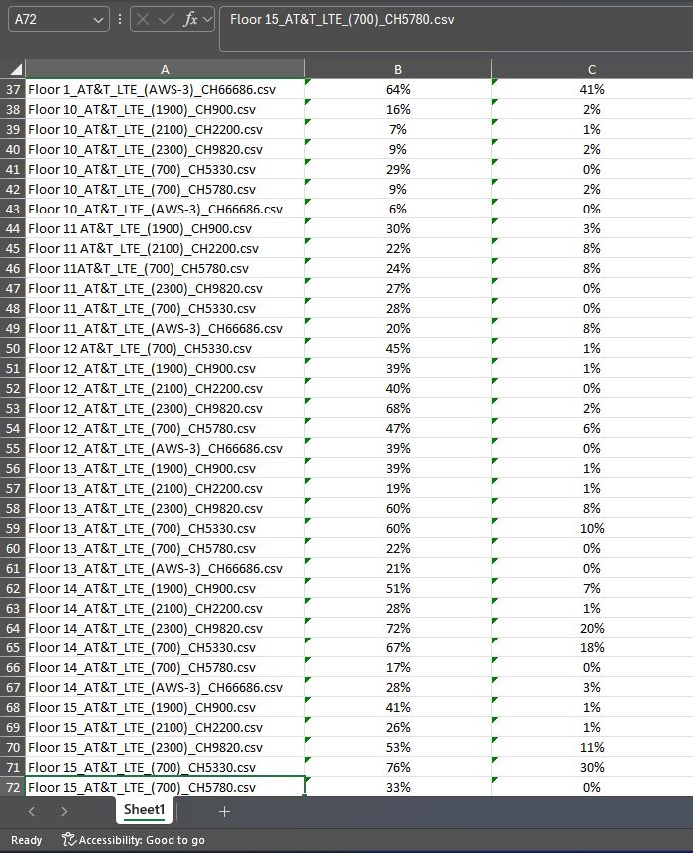
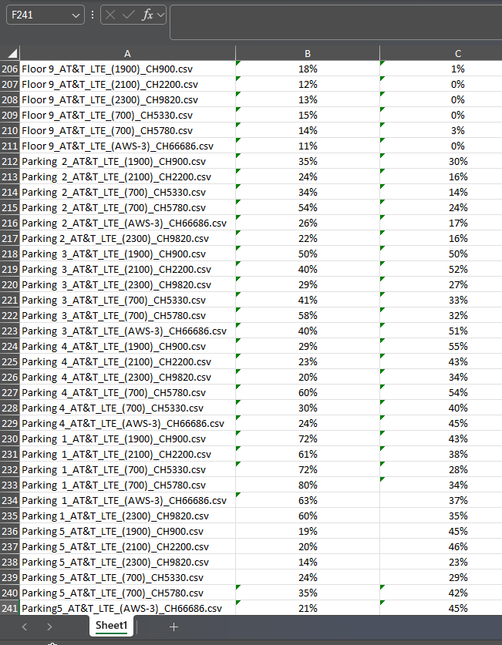
Results

